Slide 1
EXPLORATORY & CONJOINT ANALYSIS Group assignment #2
Made by: Ameyaw Ahmed Sadat

Slide 2
AGENDA
1
Insights and recommendation
2
Clustering
3
Insight about segments and recommendation
4
Conjoint analysis
5
Attribute importance and recommendation
6
Appendixes

Slide 3
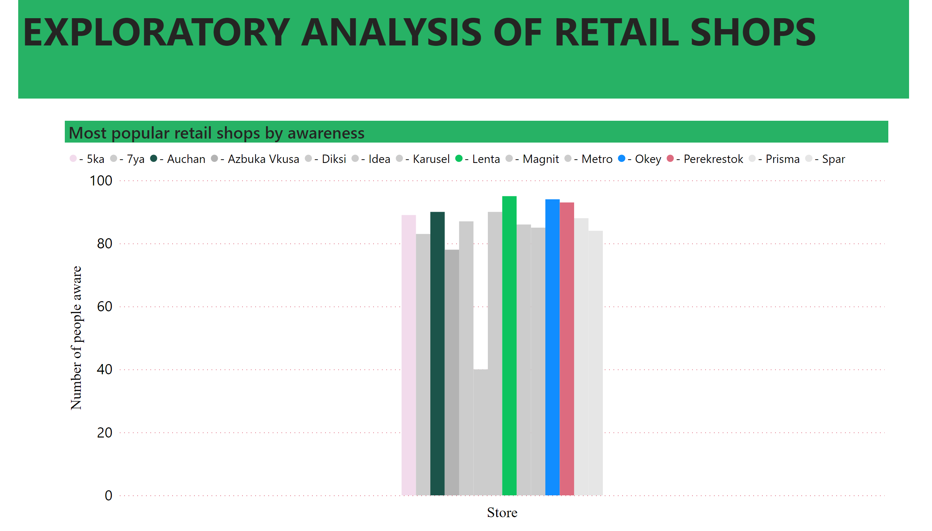
INSIGHTS

Slide 4
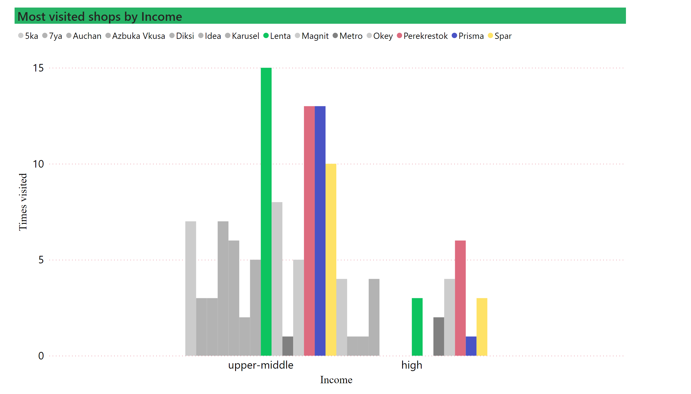
INSIGHTS
RECOMMENDATIONS
Constant ratio of price and quality
Bundling items
Value over price
Seek for luxury hence offer quality products
Mostly married with kids (advertising should target their family as well)
Create in store experience.
Make bulk purchases
Build customer loyalty and work on site reviews.

Slide 5
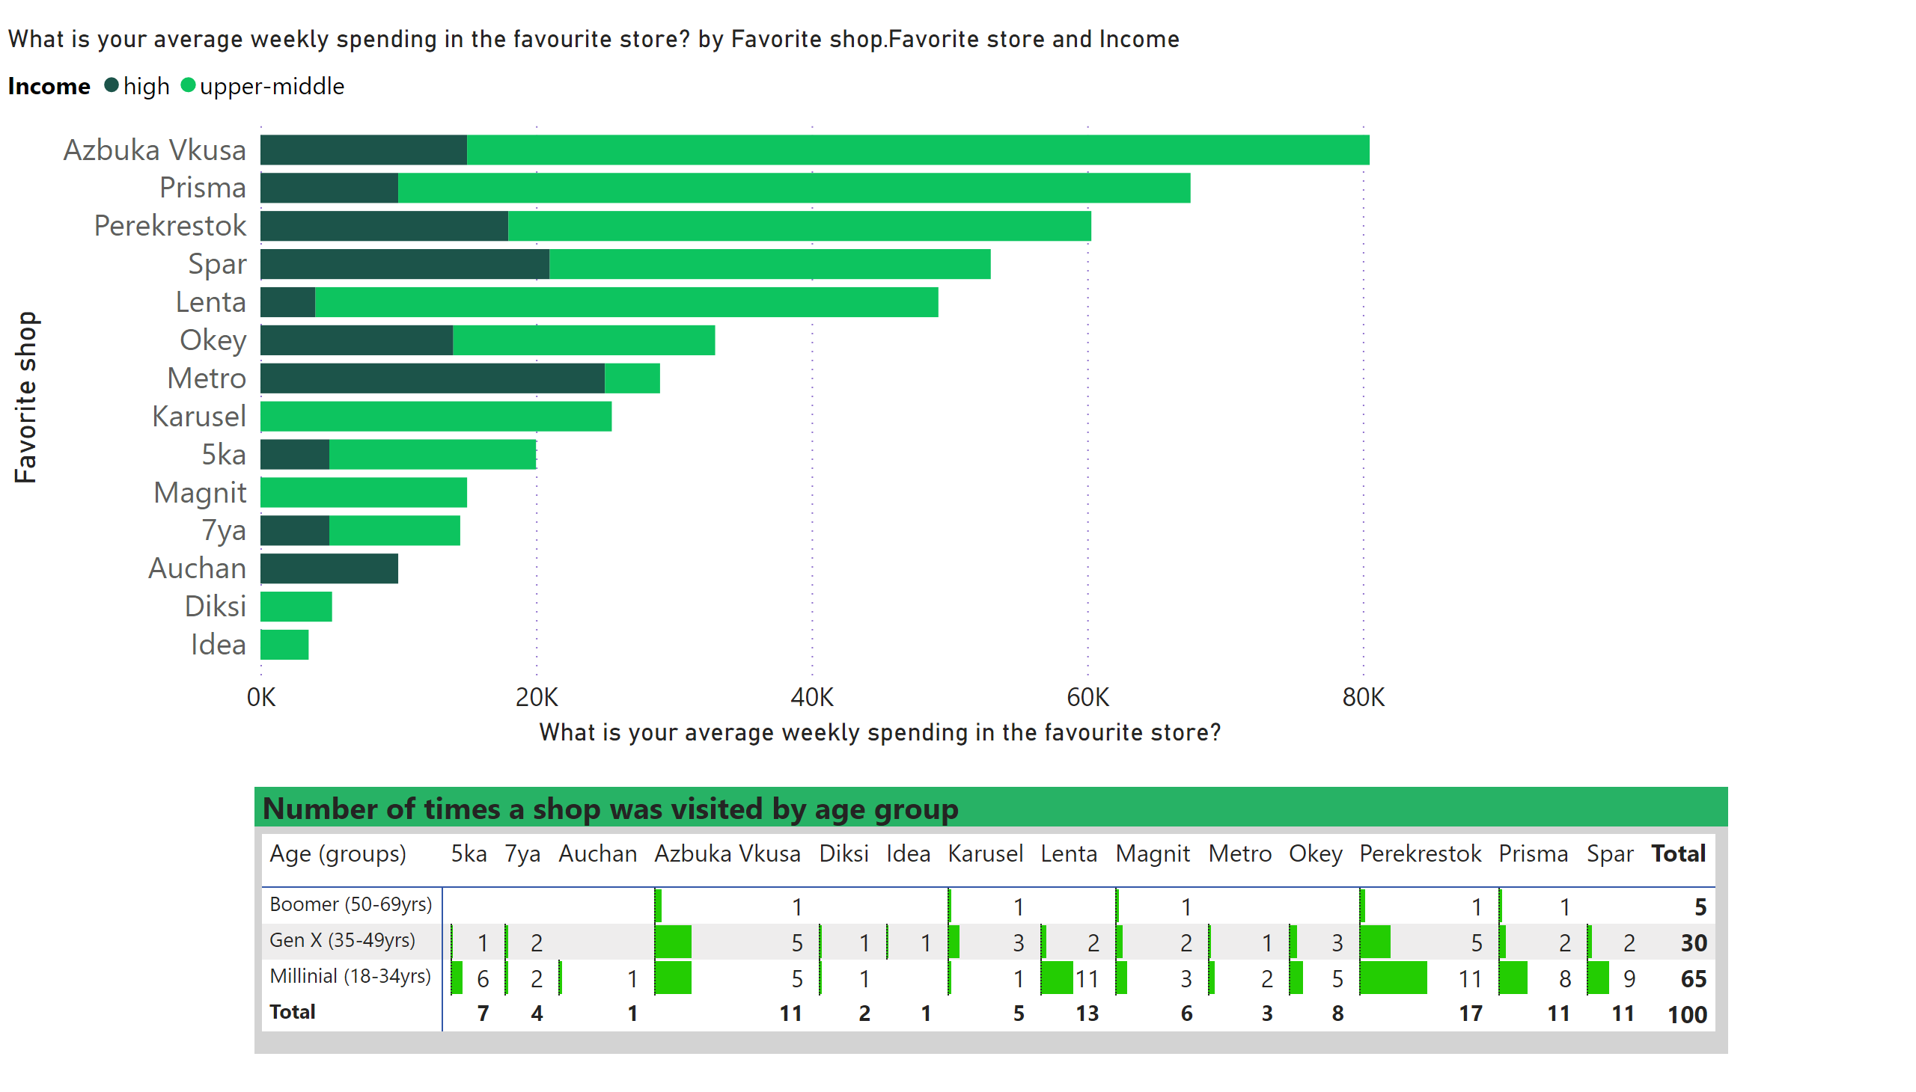
INSIGHTS
RECOMMENDATIONS
Low pricing
Convenient location
Target them digitally (Social media pages)
Text message marketing
Iintegrate advertising into their life
Product placement.
focus on experience not on products
Provide loyalty programs

Slide 6
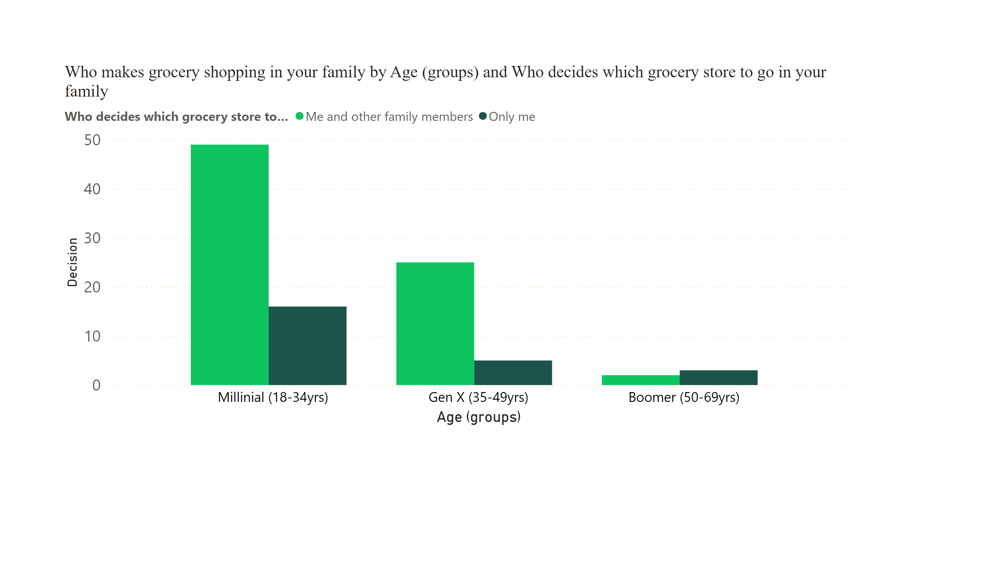
INSIGHTS
Recommendation:
Target decision markers in marketing campaign

Slide 7
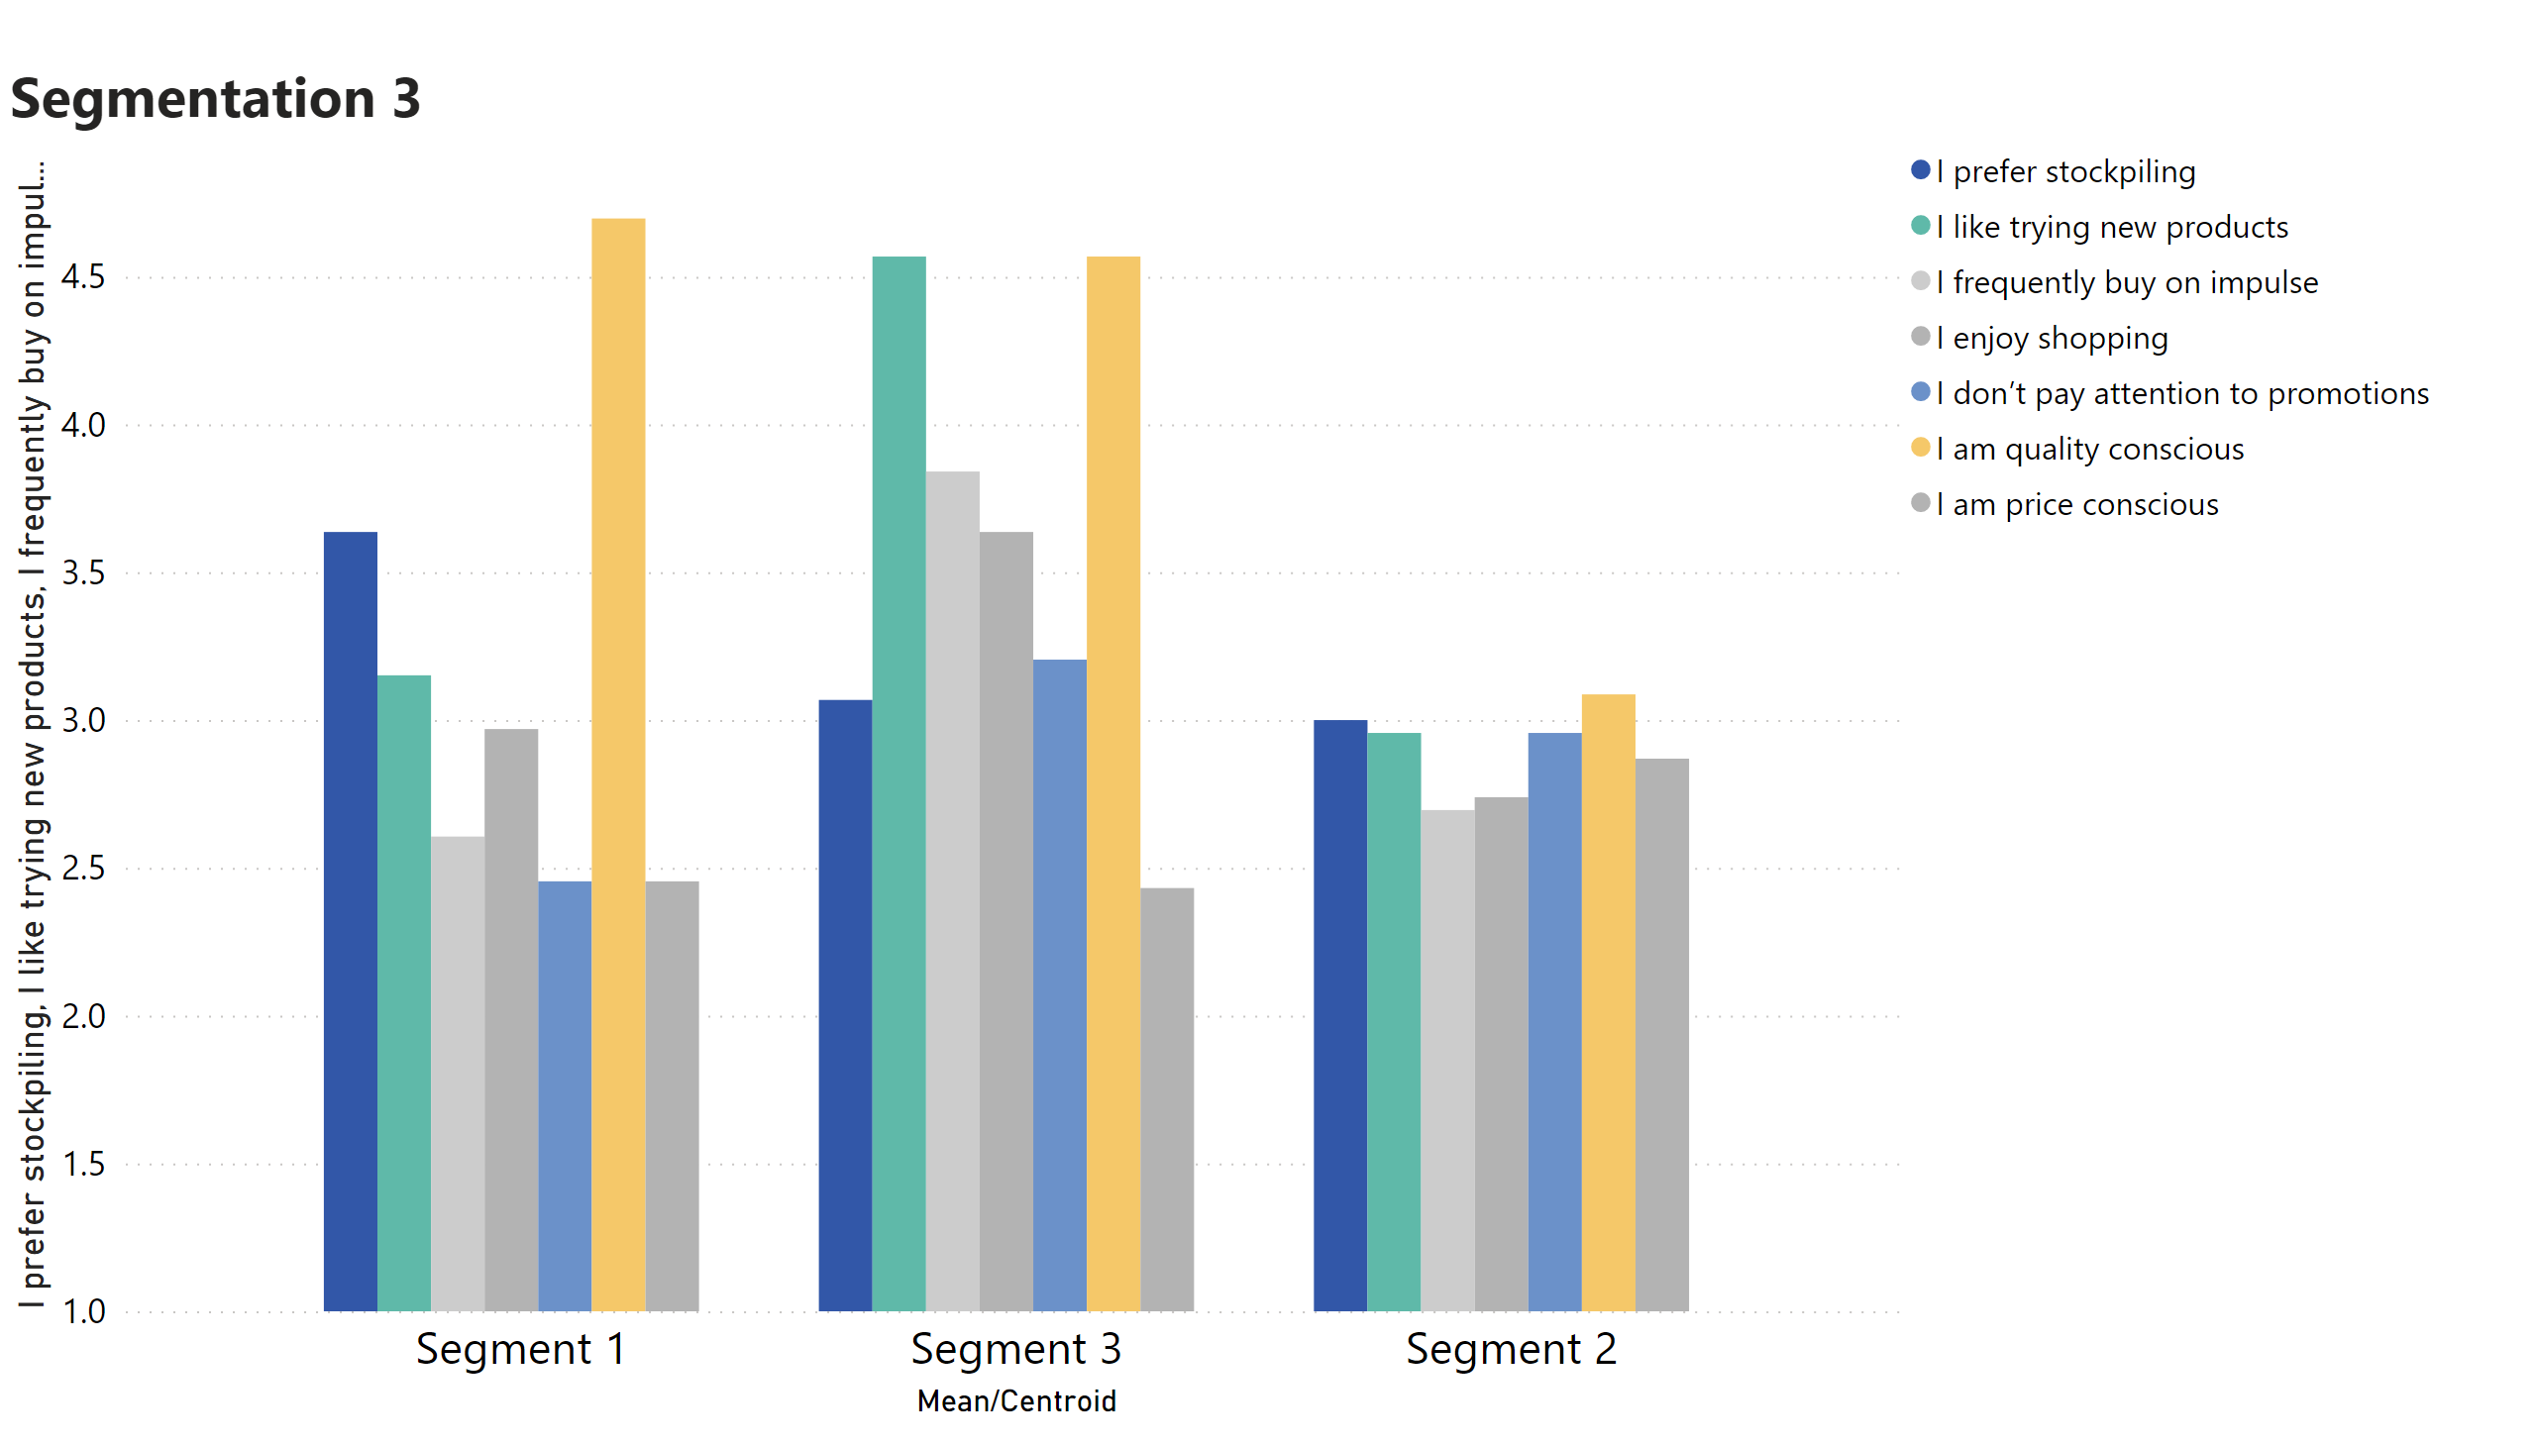
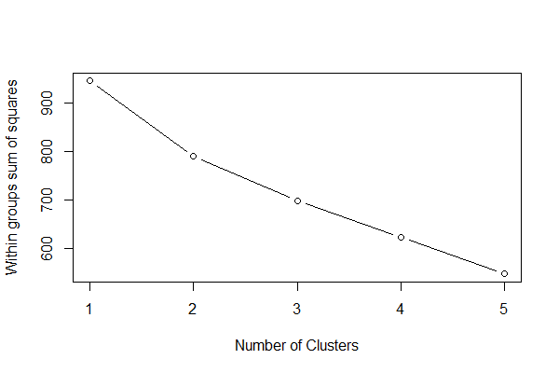
Clustering (Segmentation)
Optimal cluster

Slide 8
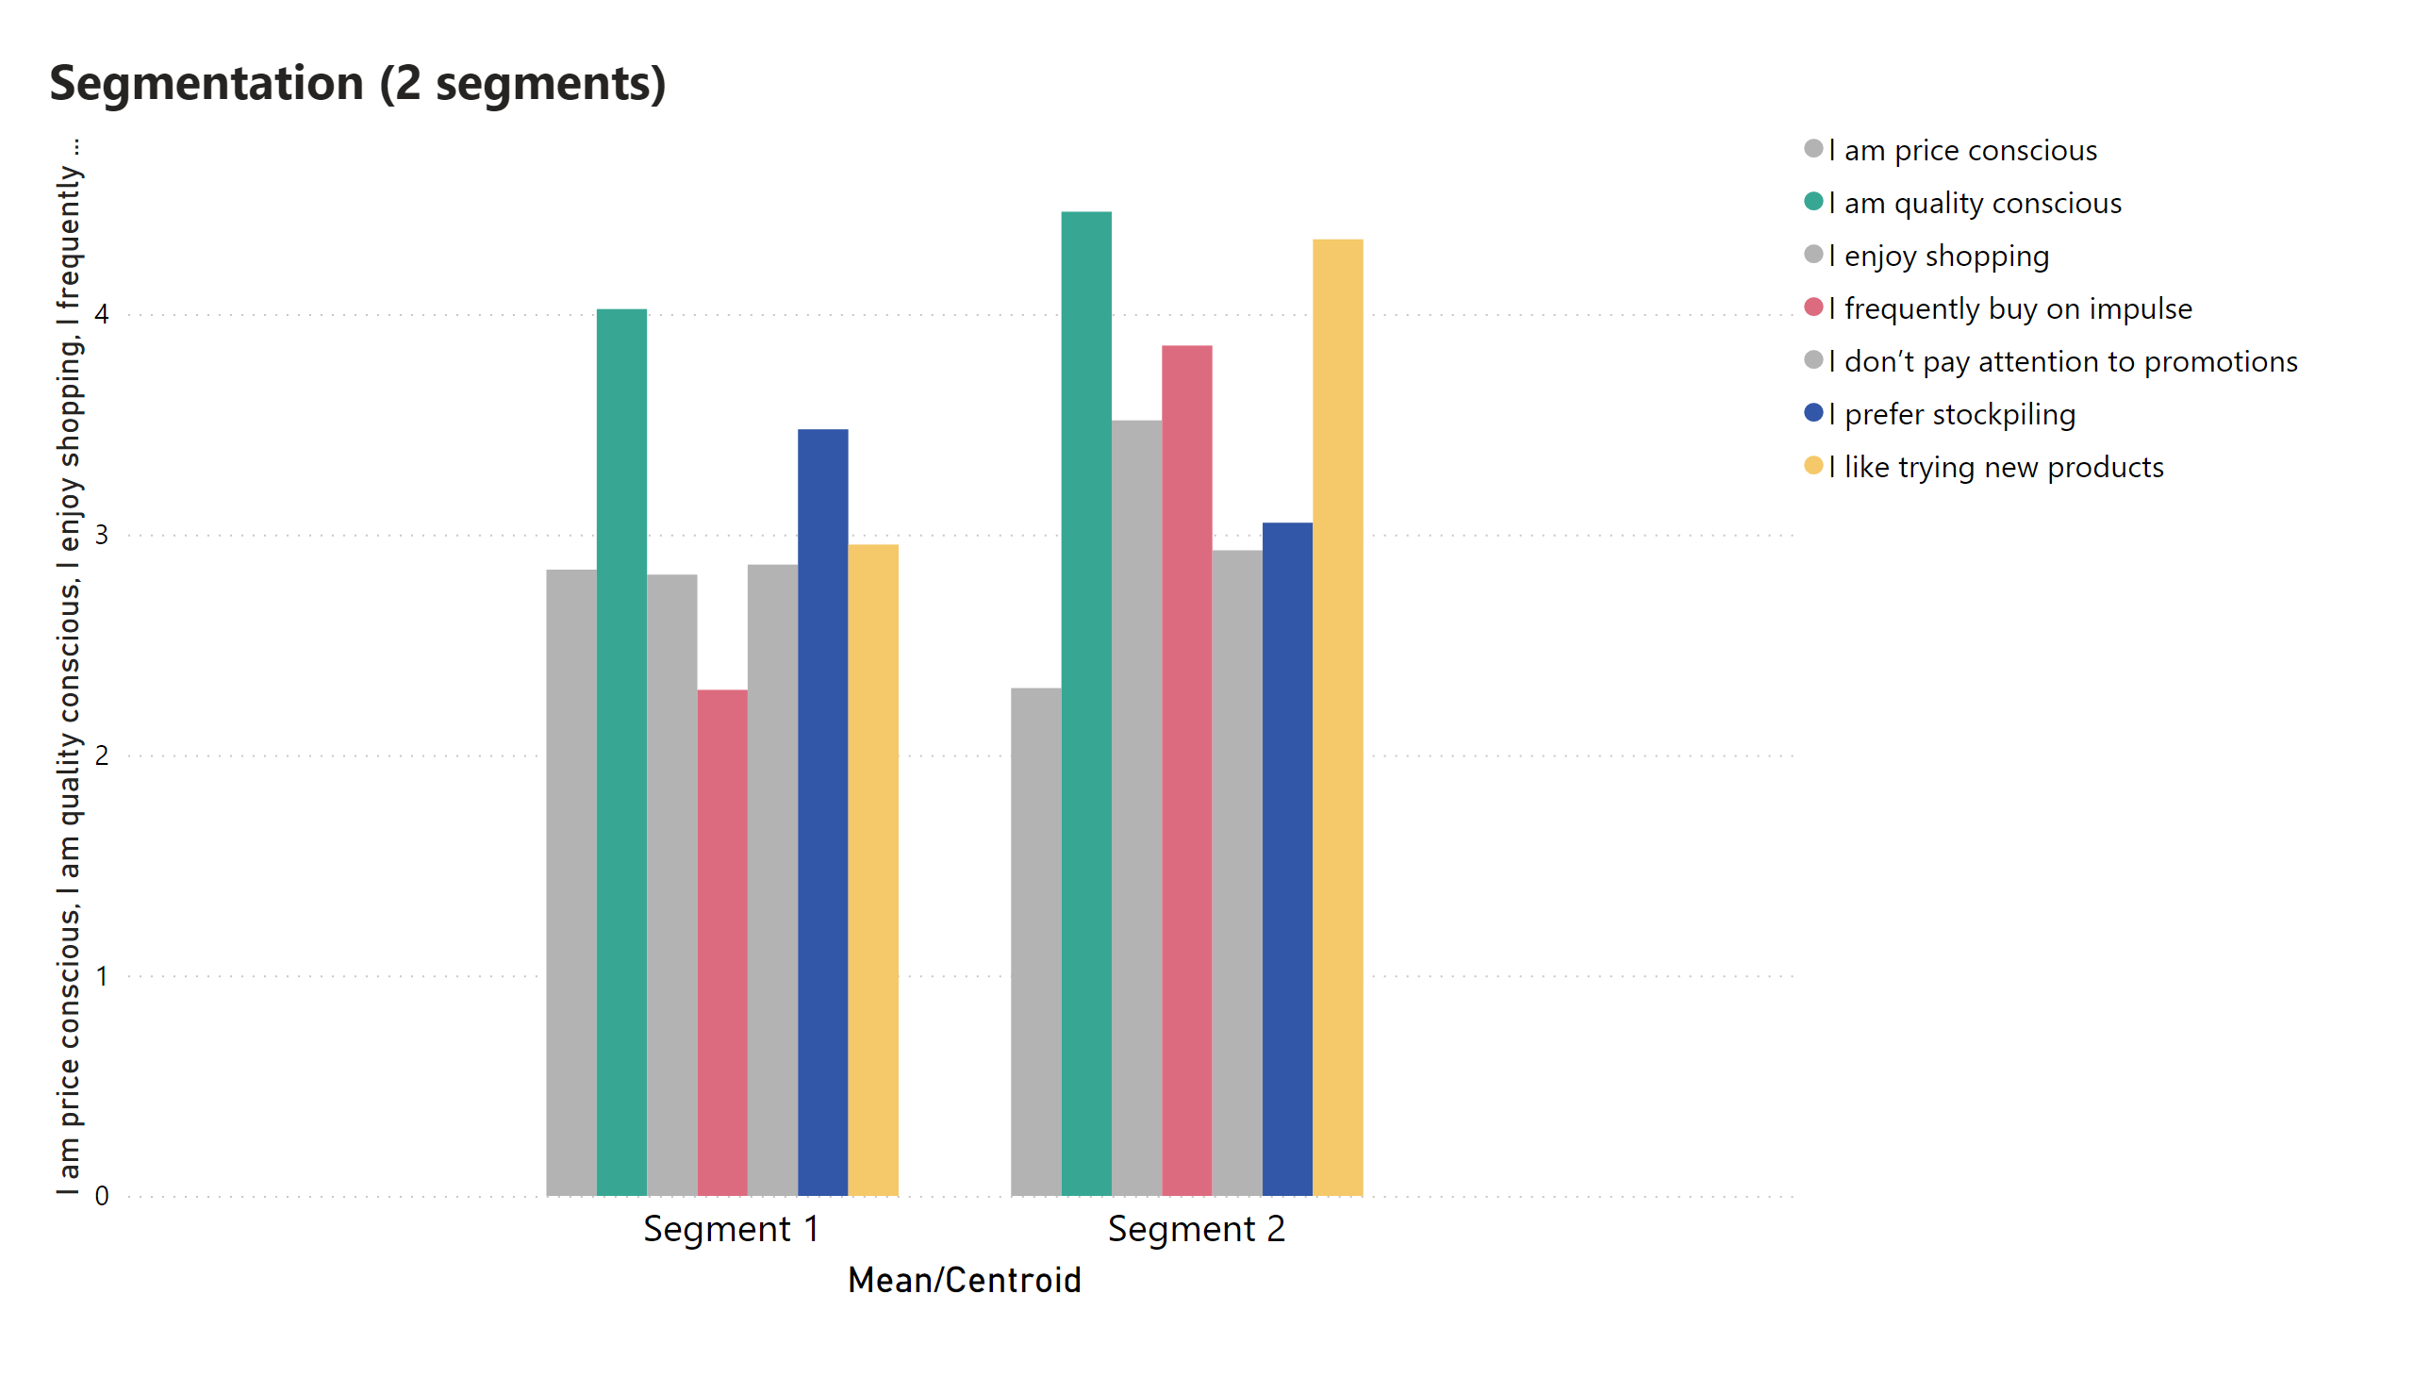
FINAL SEGMENT

Slide 9
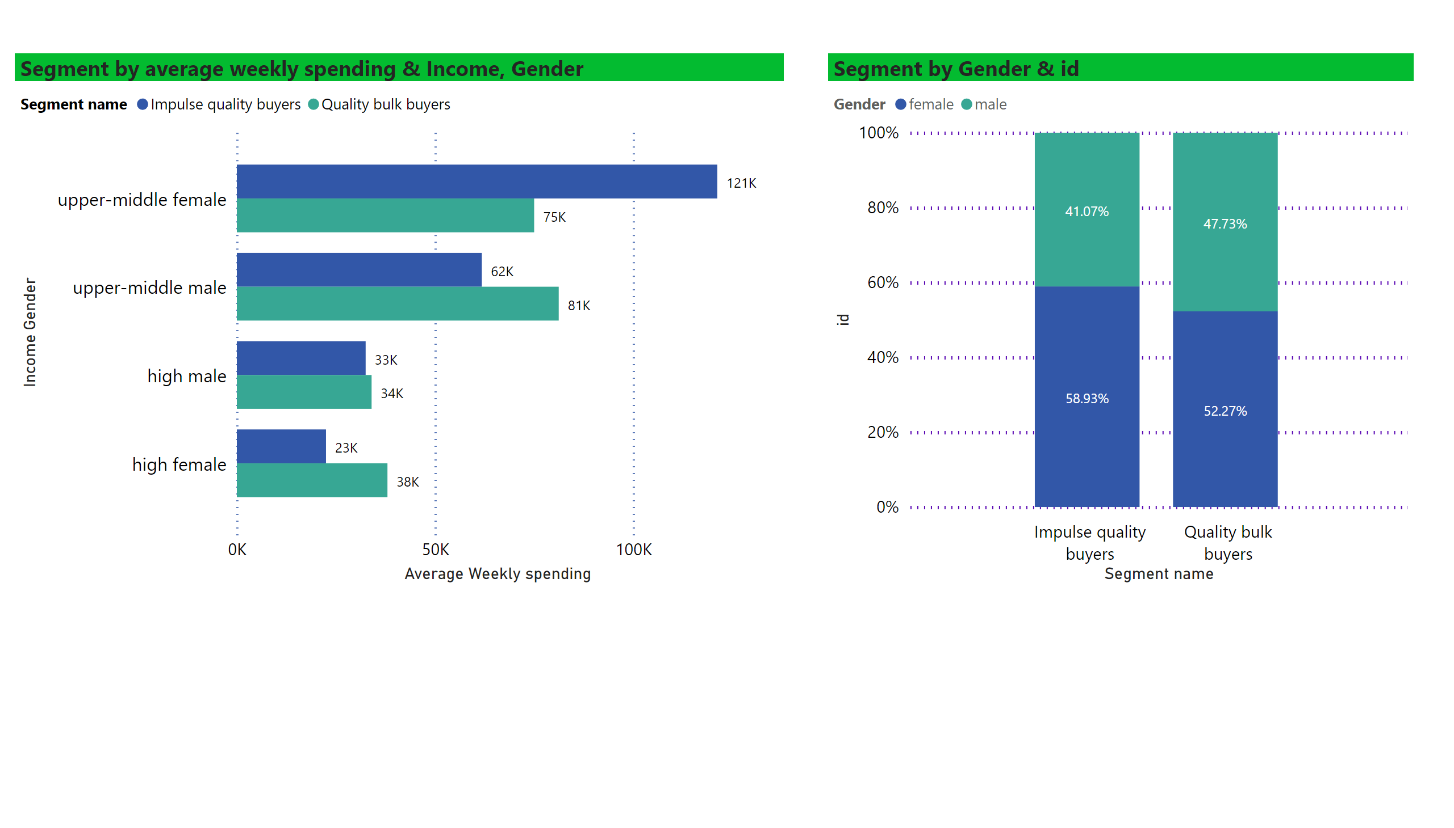
Page 6
SEGMENTS INSIGHT
Recommendations:
Place complementary products next to each other
Product bundling
Quality as key marketing message
Notes:
Segment by average weekly spending & Income, Gender
No alt text provided
Segment by Gender & id
No alt text provided

Slide 10
PART TWO (CONJOINT ANALYSIS)
Attributes | Brand | Pack format | Fat content | Price per litre
Levels | Supermarket brand | Carton | 2% | 90.00 ₽
 | Agrocomplex | Bottle | 4% | 110.00 ₽
OPTION 1: How likely are you to buy this milk if it has the following features? BRAND: Supermarket brand PACKAGE FORMAT: Carton FAT CONTENT: 2% PRICE: 90RUB
Very unlikely
Unlikely
Neutral
Likely
Very likely

Slide 11
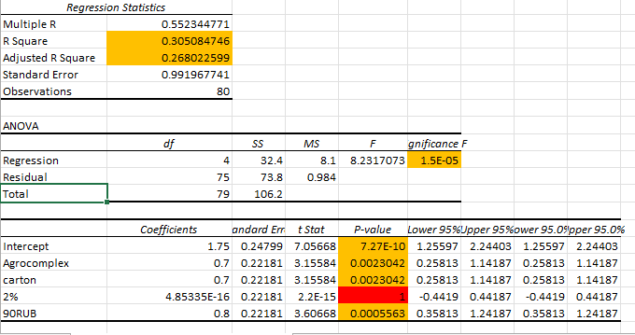
REGRESSION RESULTS

Slide 12
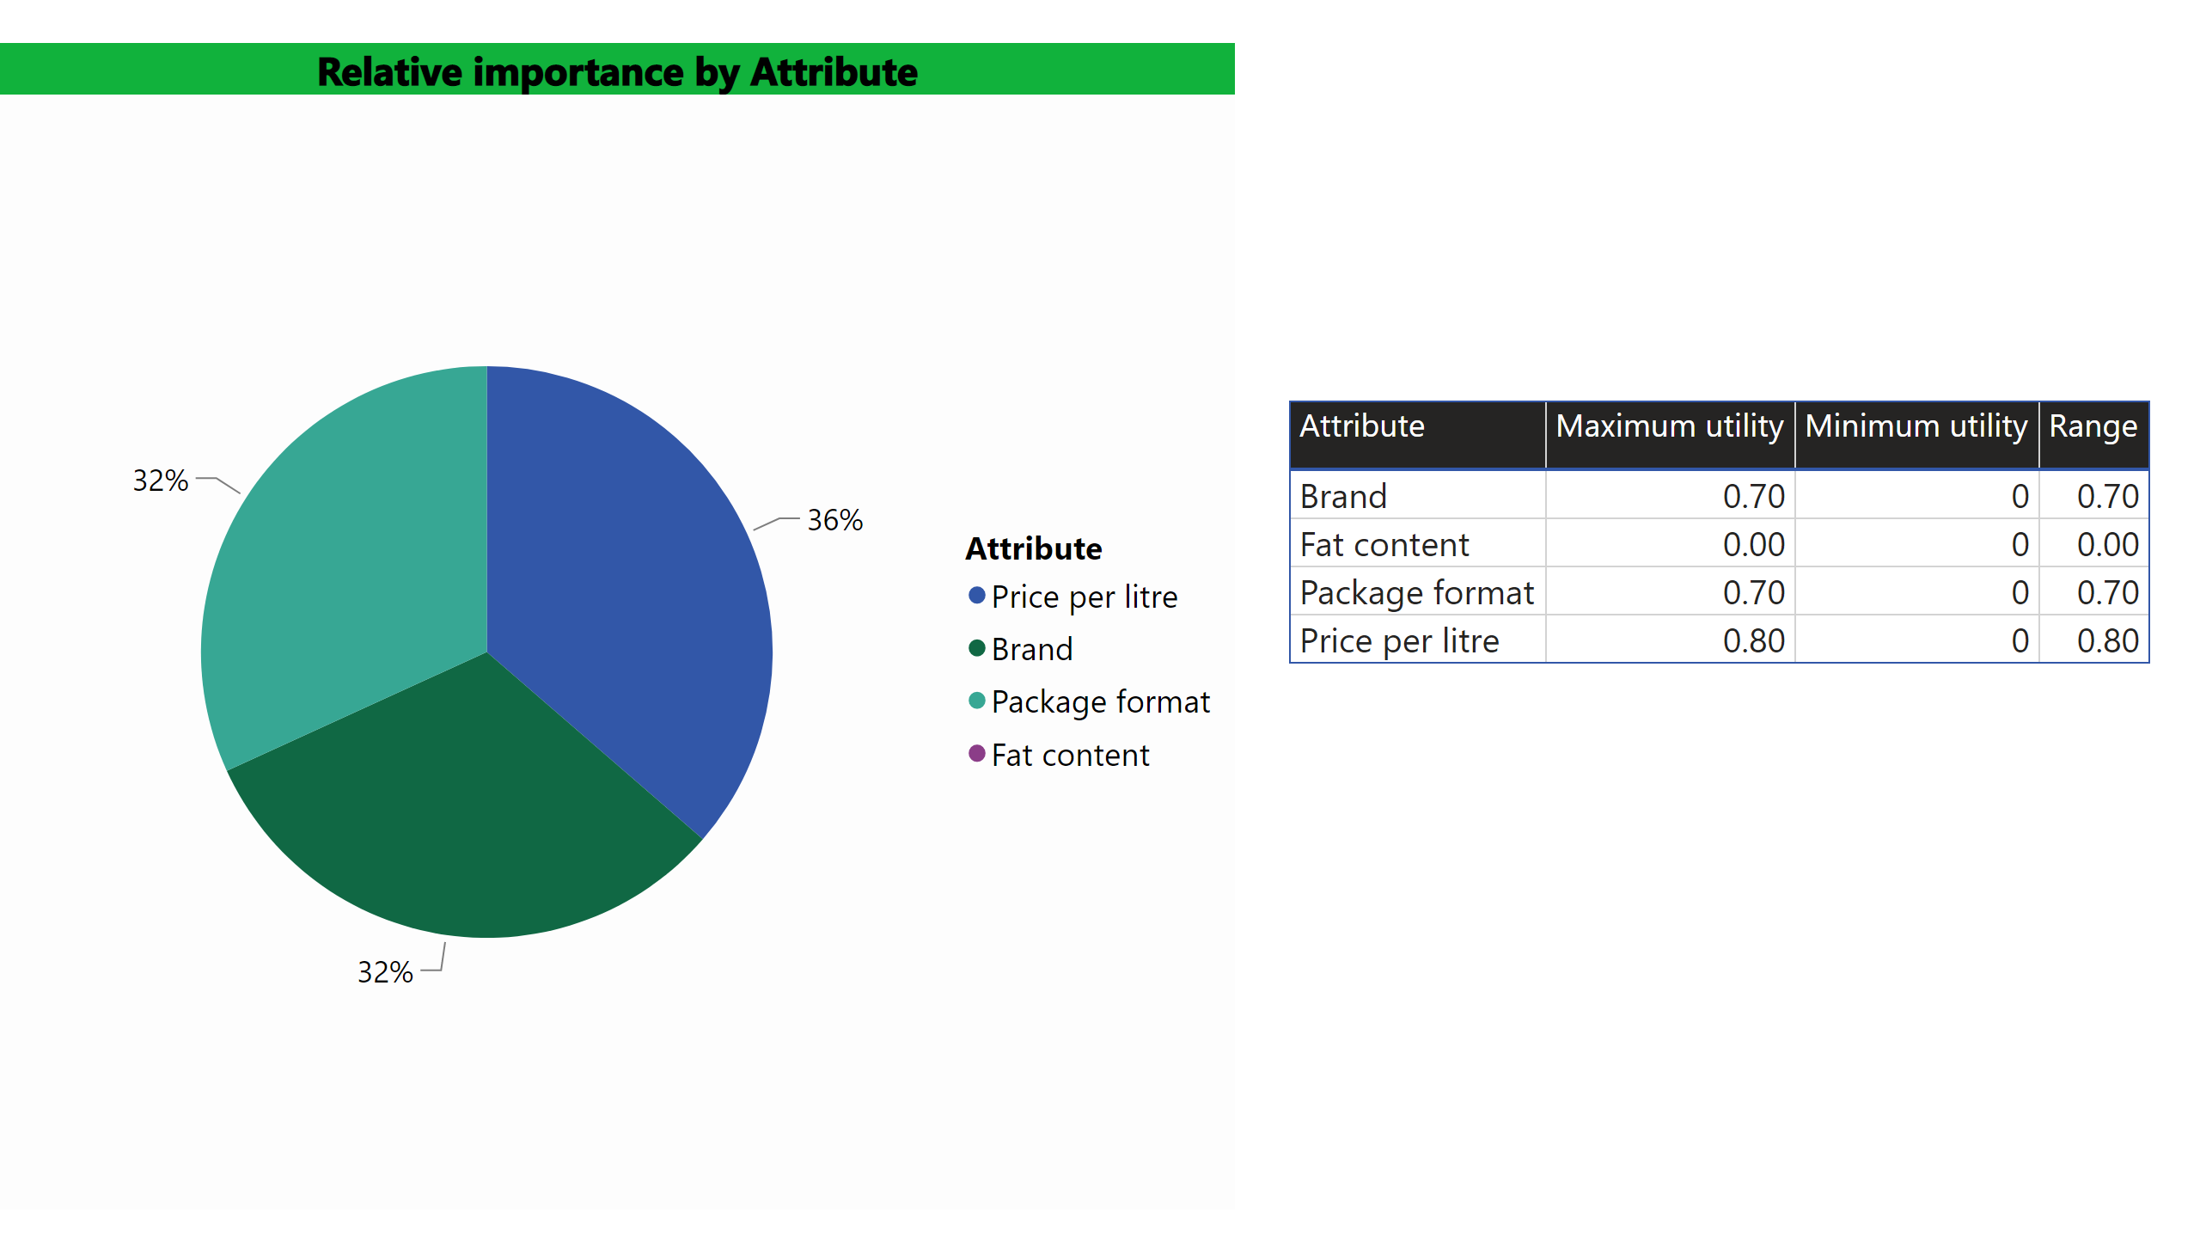
IMPORTANCE OF ATTRIBUTES

Slide 13
EXPLORATORY & CONJOINT ANALYSIS Group assignment #2
Made by: Pachurina Arina, Fedorova Sofia, Evans Nika, Ameyaw Ahmed, Mladenov Daniel, Zorina Mariia, Urovskii Denis, Zabil'skaia Valentina
Thank you for the attention!
Q&A

Slide 14
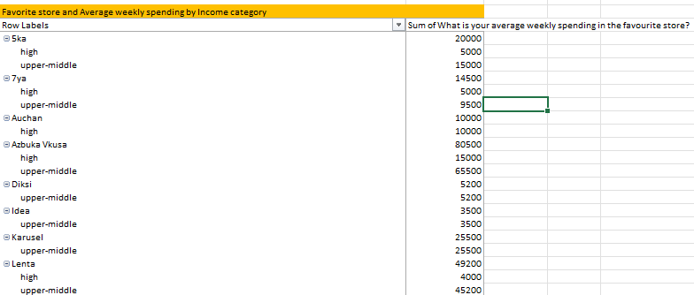
APPENDIXES

Slide 15
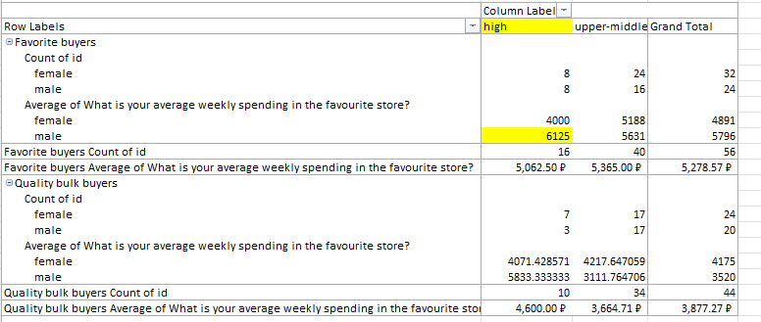
APPENDIXES

Slide 16
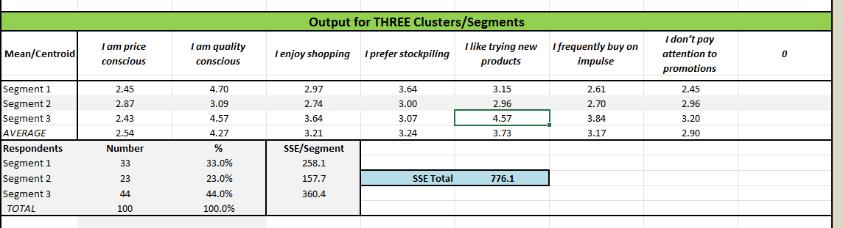
APPENDIXES

Slide 17
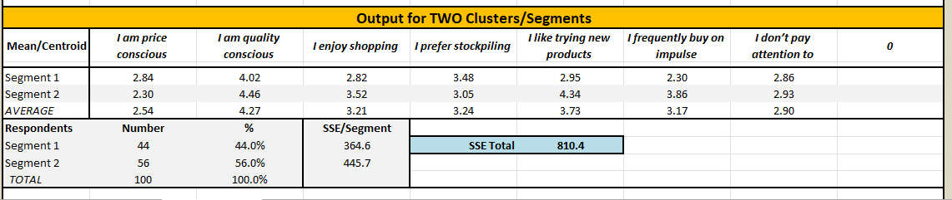
APPENDIXES

Slide 18
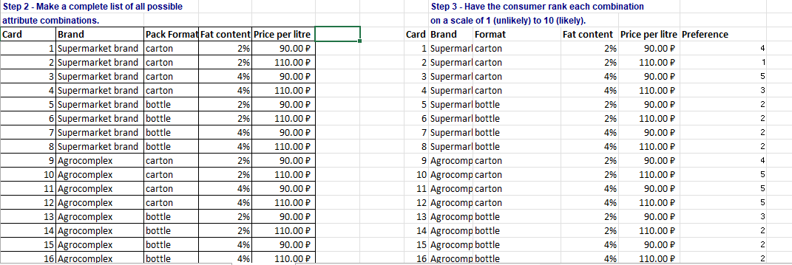
APPENDIXES

Slide 19
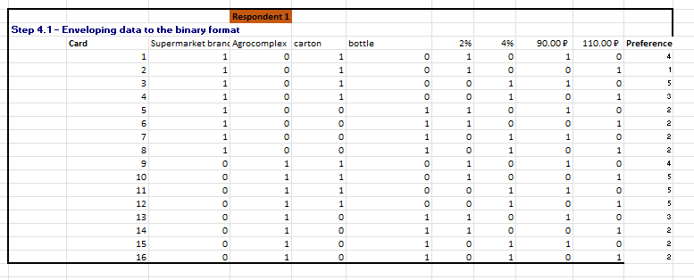
APPENDIXES

Slide 20
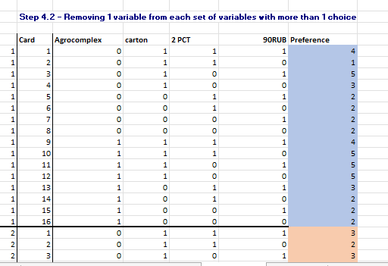
APPENDIXES

